Slide 1

Analyze Image Classification for Simple Shapes
Information Technology Course
Module Software Engineering
by Damir Dobric / Andreas Pech
Team Name: Team CrustyCrab
Team Members:
Emmanuel Otovwerakpo
Gurunag Sai Udaykumar

Slide 2
Contents
Introduction
Experiments and Results
Training Phase
Prediction Phase
Conclusion

Slide 3
Introduction
Goal: the goal is to conduct series of tests to determine the optimal parameter combination for achieving good and accurate similarity between simple images (circle, square, star, and triangle), as well as an extra function for predicting a simple untrained input image (circle, square, star and triangle).
Software program (HTM): Hierarchical temporary memory is a type of artificial intelligence that evolved from neocortex neuroscience and is now one of the most widely used applications for image recognition and anomaly detection.

Slide 4
Training Phase
Dataset: There are a lot of factors which must be consider when choosing the dataset to yield good result, these are the position of the object in the images, the orientation (angle) of the object in the images and the size of the object in the images.
Circle Square Rectangle Triangle Star

Slide 5
Training Phase
To achieve an output, there are some steps that the software go through to get the similarity of the images.
Fetch image folder
Loop all the images
Train each image 1by1with spatial pooler
Correlation matrix of input and output similarity
Find the similarity for active columns of input vectors and output SDRs
Spatial pooler should enter the stable state

Slide 6
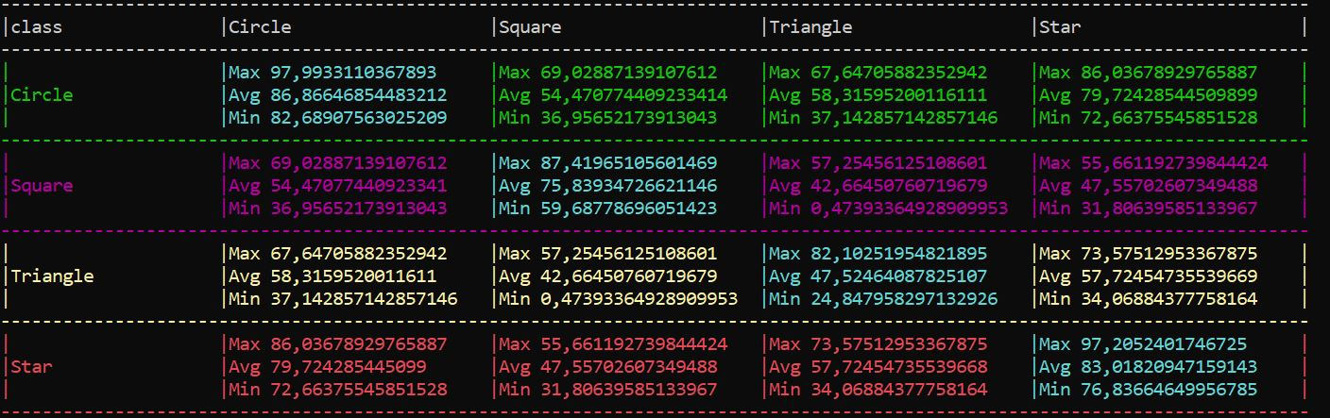
Training Phase
After several test on two dataset with an input dimensions of 64x64 and 100x100, we get a generic local area density of 0,3 and different potential radius that yields good similarity result.
Dataset 100x100 dimensions with a potential radius 30

Slide 7
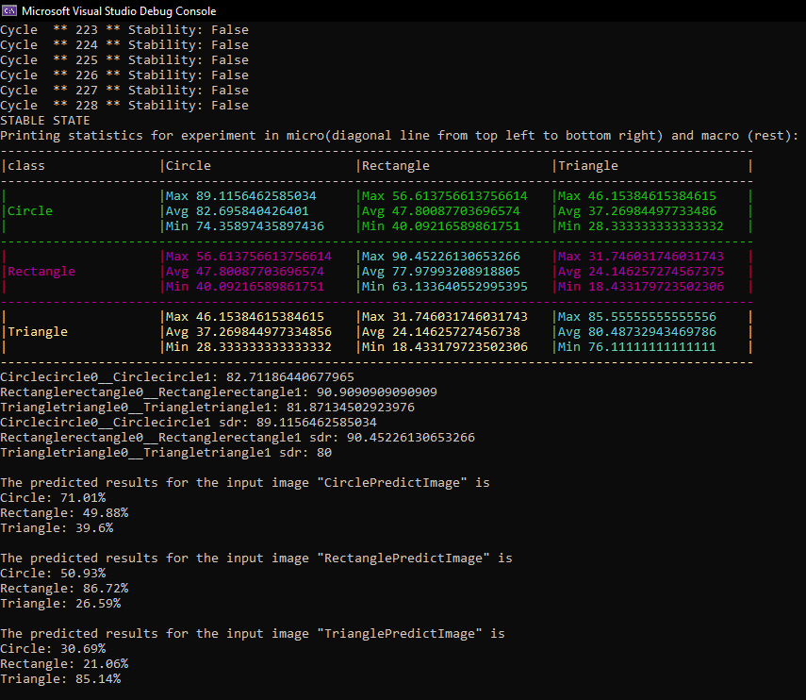
Training Phase
Dataset 64x64 dimension with a potential radius 10, Local Area Density 0.3 and Local Inhibition

Slide 8
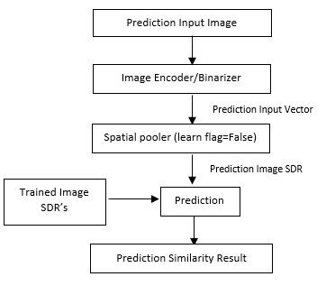
Prediction Phase
After training, the model is ready for prediction of the features of any image
Flow chart of prediction phase

Slide 9
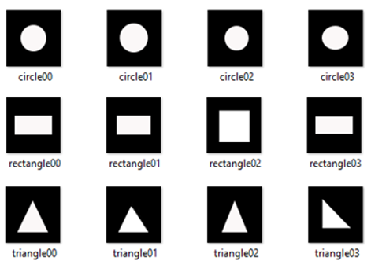

Input Dataset and Prediction Images
Training Dataset
Prediction Images

Slide 10
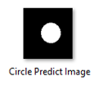

Prediction Test-1
A circle image is used as Input predict image, theoretically belongs to the trained dataset.
The training model can predict the feature in the prediction image as circle with an average similarity of 73.26%
Prediction Output

Slide 11
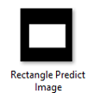

Prediction Test-2
Similar to the testcase1, a rectangle image is used for the prediction testing, belongs to the training dataset
The training model can predict the feature in the prediction image as rectangle with an average similarity of 71.07%
Prediction Output

Slide 12


Prediction Test-3
A star shaped image is input for prediction and theoretically the similarity values between the trained shapes show be very low.
From the prediction result, we can state that the feature of the star image used for prediction results in low average values for the trained dataset classes.
Prediction Output

Slide 13
Conclusion
From the experiments, the results shows that how spatial pooler parameters influence for an efficient learning of the dataset.
Similarity between the images is controlled by the LocalAreaDensity and numActiveColumnsPerInhArea parameters for effective learning.
The Image Dimensions influence the Potential Radius
For a higher LocalAreaDensity value, the active columns will be increased in spatial pooler, resulting is higher similarity between different classes.
Further, the trained data is used for feature prediction of any given input image.

Slide 14
References
[1] | "Numenta" [Online]. Available: https://numenta.com/resources/biological-and-machine-intelligence/spatial-pooling-algorithm/.
[2] | D. S. D. Sundari, "Hierarchical Temporal Memory Image Classification".
[3] | D. Dobric, "GitHub," [Online]. Available: https://github.com/ddobric/neocortexapi-classification.
[4] | O. Rukundo, "Effects of image size on deep learning," [Online]. Available: https://arxiv.org/ftp/arxiv/papers/2101/2101.11508.pdf.
[5] | Z. C. Y. Q. Z. Y. Y. X. Wen Zhuo, "Image classification using HTM cortical learning algorithms," [Online]. Available: https://ieeexplore.ieee.org/document/6460663.
[6] | H. J. a. G. D., "Hierarchical Temporal Memory: Concepts, Theory, and Terminology.," [Online]. Available: http://www.numenta.com/Numenta_HTM_Concepts.pdf.

